Slide 1
HLK 201 Helicopter Design

Slide 3
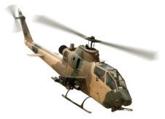
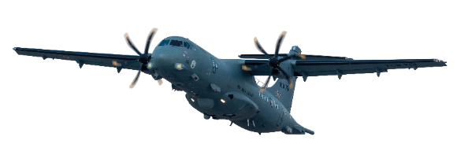
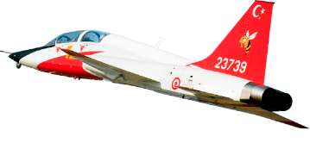
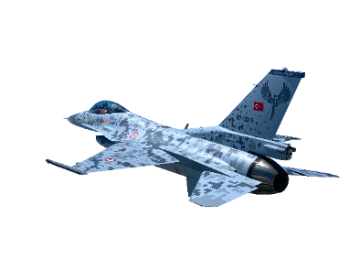
CONTENT
Familiarization
01
Title 2
02
Title 3
03
Title 4
04
Title 5
05
Title 6
06

Slide 4
İÇİNDEKİLER
Tanıtım
01
Title 2
02
Title 3
03
Title 4
04
Title 5
05
Title 6
06

Slide 5
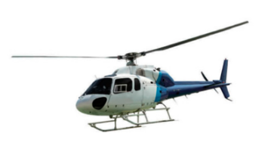
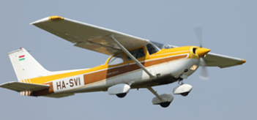
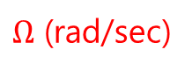
Familiarization
Aircrafts
Fixed Wings
FORCES <- PRODUCER
Thrust <- Engine
Lift <- Wings
Maneuver <- Control Surfaces
Rotary Wings
FORCES <- PRODUCER
Thrust <- Engine
Lift <- Blades
Maneuver <- Control Surfaces
$Ω$ (rad/sec)
Rotor Blades

Slide 6
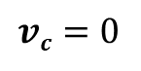

Familiarization
Rotary Wings
$$vc=0$$
T
P
T
$$vi$$
vortices: airflow disturbances

Slide 7
CONTENT
Title 1
01
Title 2
02
Title 3
03
Title 4
04
Title 5
05
Title 6
06

Slide 10
CONTENT
Title 1
01
Title 2
02
Title 3
03
Title 4
04
Title 5
05
Title 6
06

Slide 13
CONTENT
Title 1
01
Title 2
02
Title 3
03
Title 4
04
Title 5
05
Title 6
06

Slide 16
CONTENT
Title 1
01
Title 2
02
Title 3
03
Title 4
04
Title 5
05
Title 6
06

Slide 19
CONTENT
Title 1
01
Title 2
02
Title 3
03
Title 4
04
Title 5
05
Title 6
06

